Slide 1
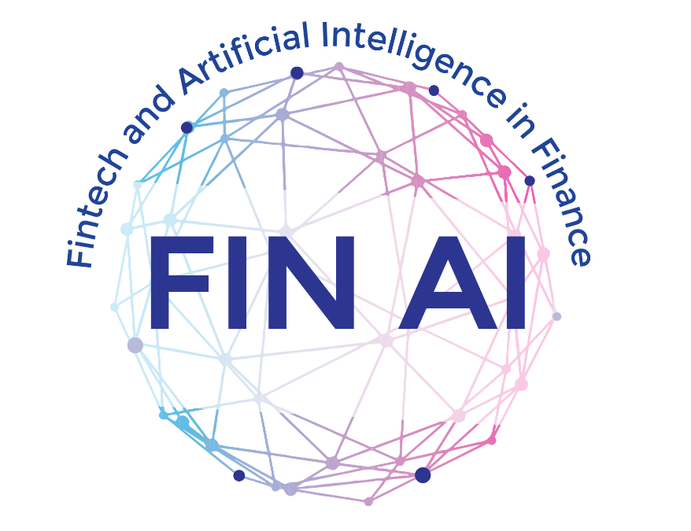
Fintech and Artificial Intelligence in Finance
Towards a transparent financial industry
County update: Italy

Slide 2
Members
Participants from universities/institutions located in different part of Italy
Fully interdisciplinary background (Business, Law, Sociology, Quantitative Methods)
Involved in the activities of all WGs
Activities GP1-GP3
Dissemination: 5 international conferences, 2 summer schools, 2 international competition (Dathathon)
Networking: 4 STSMs (incoming-2 in 2023), 3 VMG (1 in 2023), various ongoing projects .1 International PhD Network (Marie Curie-starting in 2024)

Slide 3
Main activities of GP3
Conference:
Diversity Challenges for a Sustainable Fintech
2nd workshop on Environmental finance for the common good - Fintech and AI for more sustainable societies, Pavia, 13-14 April, 2023. https://efcg2023.sciencesconf.org/
Training school:
Advanced Statistical Modelling for Fintech, financial inclusion and inequality, Naples, 13-15 September, 2023.
https://fin-ai.eu/affine/

Slide 4
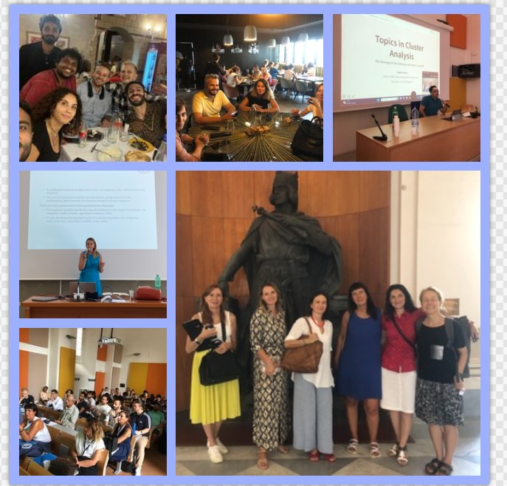
AFFINE

Slide 5
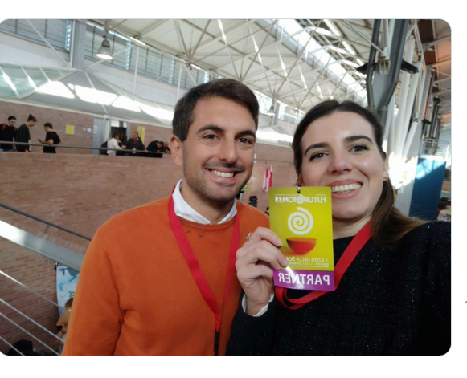

Best WI-FI 2023 Young Researcher Paper
Rosa Fabbricatore and Lucio Palazzo won the context with a project on multilevel IRT applied to Financial Literacy in Italy

Slide 6
Recent works
(2023) Anderloni,,L. Petukhina, A., Tanda, A. P2P lending platforms. Manuscript
(2023) Będowska-Sójka, B, Tarantola, C., Mare, C, Paccagnini, A., Ozturkkal, B., Pisoni, G., Perri, R. Shala, A., and Skaftadótti, H.K. Editorial boards of finance journals: the gender gap and social networks. Manuscript (under review)
(2023) Bussman, N., Giudici, P., Tanda, A , Yu, E.P . Explainable machine learning models to identify the key drivers of the implied cost of capital. Manuscript (under review).
(2023) Coita IF, Iannario M, Iodice D’Enza A, Codruta M. , Romano R. Uncertainty in Latent Trait Models and dimensionality reduction methods for complex data: an analysis of taxpayer perception on the Fiscal System. Manuscript (under review).
(2023) Colombi R., Giordano S., Kateri M., (2023) Hidden Markov models for longitudinal rating data with dynamic response styles, Statistical Methods and Applications DOI : 10.1007/s10260-023-00717-x
(2023) Dalla Valle, L, Tarantola, C. Merli, L. White-Box Sentiment Analysis-Based Approaches to Predict Cryptocurrencies. Manuscript.
(2023) Facchinetti, S., Osmetti, S.A. e Tarantola, C. A statistical approach for assessing cyber risk via ordered response models, Risk Analysis, DOI: 10.1111/risa.14186, ISSN:1539-6924.
(2023) Facchinetti, S., Osmetti, S.A. e Tarantola, C. Networks Models for cyber attacks evaluation, Socio-Economic Planning Science Volume 87, Part B, 2023, 101584, ISSN 0038-0121, https://doi.org/10.1016/j.seps.2023.101584.
(2003) Iannario M., Tanda A. and Tarantola C. A latent variable approach to Millennials’ knowledge of green finance , book of short paper SIS2023, Pearson
(2023) Del Vitto, A., Marazzina, D., ,Stocco D. ESG ratings explainability through machine learning techniques, Annals of Operations Research, DOI:10.1007/s10479-023-05514-z
(2023) Fabbricatore, R., Palazzo, L. Multilevel IRT models to explore heterogeneity in subjective financial knowledge at individual and regional levels: the Italian case. Frontiers in Applied Mathematics and Statistics.
(2023) Fabbricatore, R. Iannario, R. Palazzo, L. , Palumbo, F. .Modeling gaps in FinTech knowledge. Book of Short Paper ASA.
(20223) Ozturkkal; B, Zdravevski; E., Tanda;A., Mare, C.; Ranik Raaen Wahlstrøm; Vladimir Trajkovik; Petre Lameski VC bibliometric review. Manuscript (under review).
(2023) Palazzo, L., Iannario, M., Palumbo, F. .Integrated assessment of financial knowledge through a latent profile analysis Manuscript (under review).

Slide 7
Advanced Statistical Modelling for data science in Digital Age
20 October, DISP (Naples)
Hybrid event
Keynote speakers
Nial Friel, University College Dublin
Rita Cappariello, Bank of Italy

Slide 8
International Fintech Research Conference
FINANCE, TECHNOLOGY, METHODOLOGIES
PARTHENOPE UNIVERSITY OF NAPLES | 2-3 NOVEMBER 2023
The Conference aims to put together researchers working in all areas of Fintech (banking, asset management, insurance, payments, capital markets, internet of things) providing a multidisciplinary venue.
Keynote speakers
Juri Marcucci, Banca d’Italia
Stefan Thurner, University of Vienna
https://www.disaq.uniparthenope.it/fintechlab/international-fintech-research-conference/

Slide 9
Master in Artificial Intelligence & Data Science, Unical
This online master's program in Artificial Intelligence & Data Science provides a specialized dual curriculum. The first track hones expertise in advanced Artificial Intelligence techniques, while the second track focuses on crafting skilled Data Scientists. Both pathways emphasize a strong foundation in computer science, statistics, and machine learning.
https://desf.unical.it/didattica/formazione-post-laurea/master-artificial-intelligence-and-data-science/

